Slide 1
Network Security

Slide 2
Introduction
Definitions
Security methods.
Attacks and malicious code

Slide 3
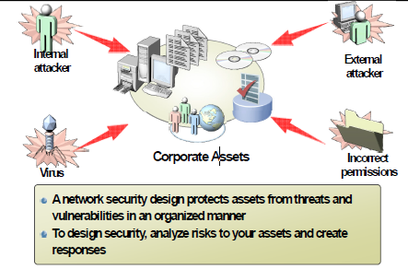
Why secure a network

Slide 4
Security of system resources
Three-step process (AAA)
Authentication
Positive identification of person/system seeking access to secured information/services
Authorization
User’s level of access to resources
Accounting
Record of each asset’s use
Notes:
Something some you know ( password)
Something you have ( smartcard)
Something you are ( biometrics)
Or a combination ( multi-factor)

Slide 5
Information Security
3 Fundamental Principles of Security
Confidentiality: Protection of data from unauthorized disclosure to a third party
Integrity: Assurance that data is not altered or destroyed is an unauthorized manner
Availability: Continuous operation of computing systems
Notes:
Một số đe doạ đối mặt với mạng là:
• Việc bên thứ ba nghe trộm nội dung trao đổi.
• Việc bên thứ ba giả mạo nội dung trao đổi
• Người không có thẩm quyền xâm nhập vào mạng

Slide 6
Security threat trends
A vulnerability A software hardware or procedural weakness that may provide an attacker the opportunity to obtain unauthorized access.
A threat is an unauthorized access to a network
A risk

Slide 7
Causes of network security vulnerabilities
Technology weaknesses
Configuration weaknesses
Policy weaknesses
Human error

Slide 8
Technology weaknesses
TCP/IP
Operating systems
Network equipment

Slide 9
Configuration weaknesses
Unsecured accounts
Weak passwords
Misconfigured Internet services
Unsecured default settings
Misconfigured network equipment
Trojan horse programs
Viruses

Slide 10
Human error and malice
Human error
Accident
Ignorance
Workload
Malice
Dishonesty
Impersonation
Disgruntled employees
Snoops
DoS attacks
Identity theft

Slide 11
Electronic encryption and decryption concepts
Encryption
Converts plain text message into secret message
Decryption
Converts secret message into plain text message
Symmetric cipher
Uses only one key
Asymmetric cipher
Uses a key pair (private key and public key)

Slide 12
Electronic encryption and decryption concepts
Certificate Authority (CA)
Trusted, third-party entity that verifies the actual identity of an organization / individual before providing a digital certificate
Digital Certificate
A digital Certificate is a users digital identity. It has the necessary information to identify a user and allow the basis for secure communication with a user.

Slide 13
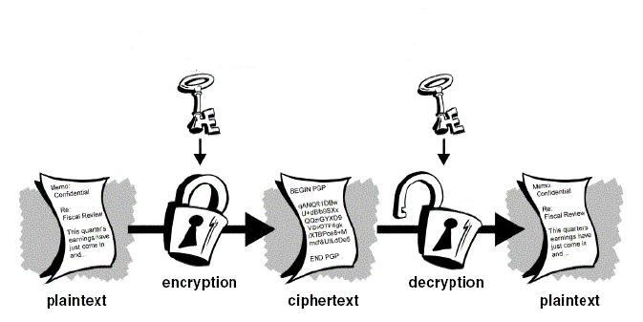
Symmetric key cryptography
Single key – works in both directions ( the same key used to encrypt will also decrypt the cipher text)
Very fast encryption / decryption
Key used for short time and discarded (session key)

Slide 14
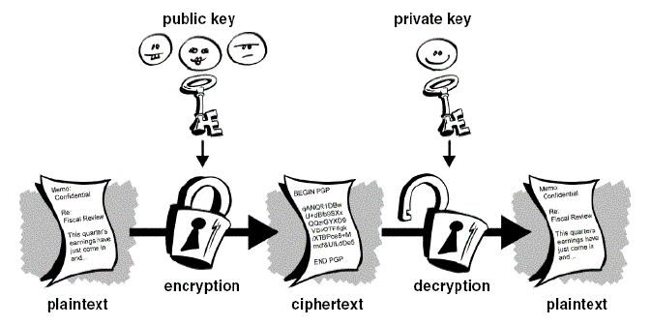
Asymmetric key cryptography
Two keys – one made public and one kept securely private.
One-way – cipher text encrypted with one of the keys can only be decrypted with the other key.
Slow encryption / decryption
Used to encrypt small amounts of data (session keys, for example)

Slide 15
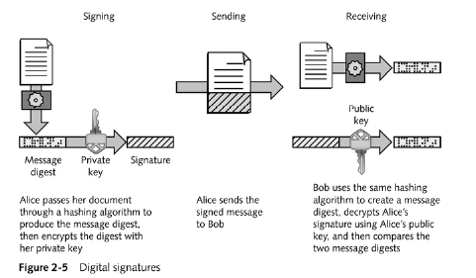
Digital Certificates

Slide 16
Secure Sockets Layer (SSL)
SSL protocol developed by Netscape to securely transmit documents over the Internet
Two-way authentication using public-key certificates
Confidentiality
Message integrity

Slide 17
Secure Sockets Layer (SSL)
HTTP
SSL
TCP
IP
The designers of SSL decided to create a separate protocol layer
The introduction of a separate protocol allows SSL to support applications other than HTTP

Slide 18
Secure Hypertext Transport Protocol (HTTPS)
One common use of SSL is to secure Web HTTP communication between a browser and a Web server
Sometimes designated HTTPS, which is the extension to the HTTP protocol that supports it
Whereas SSL/TLS creates a secure connection between a client and a server over which any amount of data can be sent security, HTTPS is designed to transmit individual messages securely

Slide 19
Secure Hypertext Transport Protocol (HTTPS)
SSL uses the following process to verify authentication credentials
The client checks the server’s certificate validity period. The authentication process stops if the current date and time fall outside of the validity period.
The client verifies that the issuing Certificate Authority (CA) is on it's list of trusted CA's.
The client uses the CA’s public key to validate the CA’s digital signature on the server certificate. If the digital signature can be verified, the client accepts the server certificate as a valid certificate issued by a trusted CA.
To protect against man-in-the-middle attacks, the client compares the actual DNS name of the server to the DNS name on the certificate.
If all checks are successful, the client continues with the SSL handshake process.

Slide 20
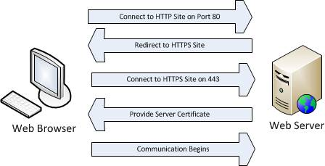
Secure Hypertext Transport Protocol (HTTPS)

Slide 21
Secure Electronic Transactions (SET)
Open encryption & security specification to protect Internet credit card transactions
Developed in 1996 by Mastercard, Visa etc not a payment system
Rather a set of security protocols & formats
secure communications amongst parties
trust from use of X.509v3 certificates
privacy by restricted info to those who need it

Slide 22
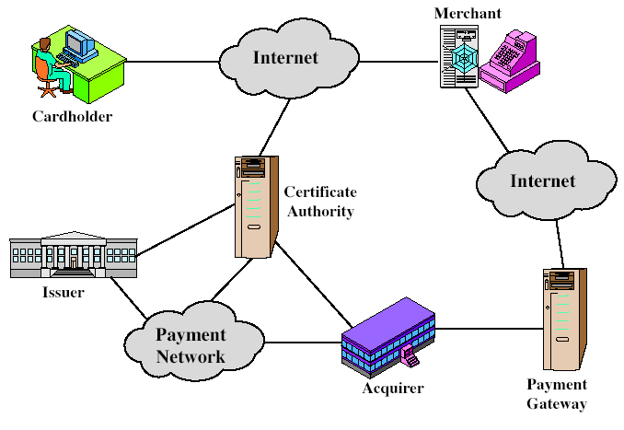
SET Components
Notes:
customer opens account
customer receives a certificate
merchants have their own certificates
customer places an order
merchant is verified
order and payment are sent
merchant requests payment authorization
merchant confirms order
merchant provides goods or service
merchant requests payment

Slide 23
Firewalls
Devices designed to implement and enforce an organizations network security policy.
Firewalls inspect incoming / outgoing packets and compare it against an access control list in order to determine whether that network packet should be allowed to pass through or be rejected
Can be hardware or software based
Can operate on layer 4 and above
Notes:
Tường lửa là hệ thống an ninh được thiết lập giữa mạng nội bộ và Interent, và nó bao gồm một mạng
(được gọi là “phần rào chắn”) gồm các máy phục vụ được kết nối (các máy phục vụ WWW, các máy
phục vụ thư, v.v..)
Vai trò cơ bản của tường lửa là kiểm soát việc chuyển dữ liệu và cho phép hoặc từ chối chuyển dữ liệu
bằng việc lọc do bộ chọn đường thực hiện. Đồng thời, các giao tác giữa mạng nội bộ và Internet cũng
được chuyển tiếp thông qua máy phục vụ uỷ quyền PROXY server để ngăn chặn các máy tính bên
trong công ti không cho truy nhập trực tiếp vào Internet.

Slide 24
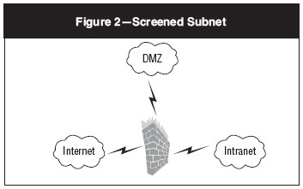
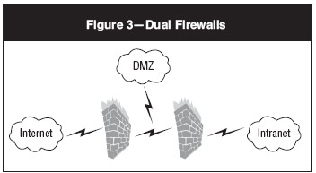
Deployment Type
Notes:
Máy phục vụ web có thể được đảm bảo bằng cách sử dụng tường lửa. Tường lửa hình thành nên rào
chắn giữa internet và mạng.

Slide 25
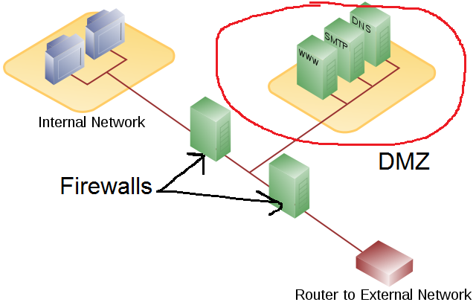
Demilitarized Zone

Slide 26
Intrusion Detection Systems (IDS)
IDS are a tool in a layered security model. The purpose of an IDS is to:
Identify suspicious activity
Log activity
Respond (alert people)
Form:
Host DIS
Network DIS
Types of detection
Anomaly-based detection
Signature-based detection
Notes:
Some things a HIDS will looks at
Logins
System or Application Log files / audit files
Changes to software or configuration files
Processes being launched or stopped
Use of certain programs
CPU usage
Network Traffic to/from Computer
Monitors activity on a specific network segment (watches the packets as they go by)
A NIDS system will often look for
DoS Attacks
Ping Scans
Port Scans
Malicious content
Vulnerability tests
Tunneling
Brute Force Attacks

Slide 27
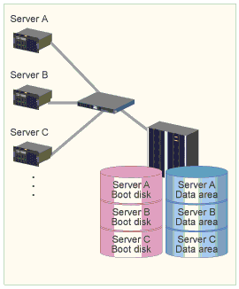
Redundancy
One important concern in DR planning is to determine resources that are a single point of failure which could halt your critical business functions.
Storage resources
Important Servers
Network Connections
Notes:
Cần phải được đảm bảo rằng tất cả các chức năng củamạng nội bộ không dừng trong trường hợp lỗi ở
bất kỳ thiết bị nội bộ nào trong mạng. Do đó, cần phải thu xếp cấu hình hệ thống dư thừa cho các máy
móc và thiết bị quan trọng nhất, như đường truyền và các thiết bị kiểm soát truyền.
Bằng cách chuẩn bị hai hay nhiều thiết bị giống nhau, có thể chuyển từ thiết bị chính sang thiết bị phụ
khi có lỗi xảy ra trong thiết bị chính để cho các chức năng của mạng có thể được duy trì. Cấu hình dư
thừa này cũng được áp dụng cho các máy phục vụ như DNS và các máy phục vụ cơ sở dữ liệu.
Trong trường hợp mạng kết nối hai vị trí, thì đườngdự phòng, như đường điện thoại công cộng nên
được chuẩn bị trước cho các trường hợp khẩn cấp, bên cạnh đường thuê bao tốc độ cao được sử dụng
trong tình huống thông thường.

Slide 28
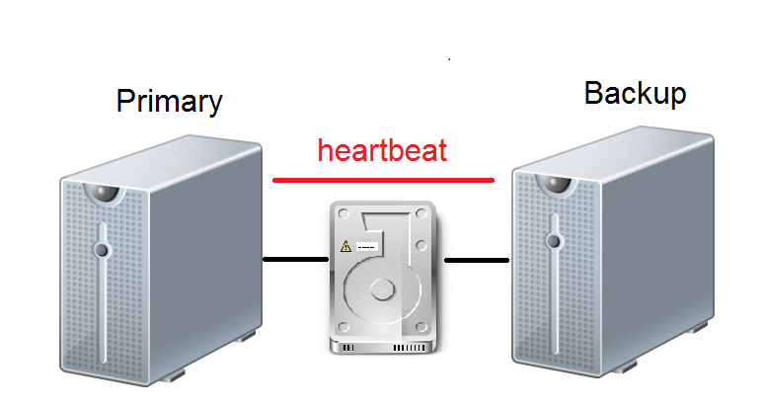
Redundancy

Slide 29
Backup
Backup Types
Full backup
Incremental Backup
Differential backup

Slide 30
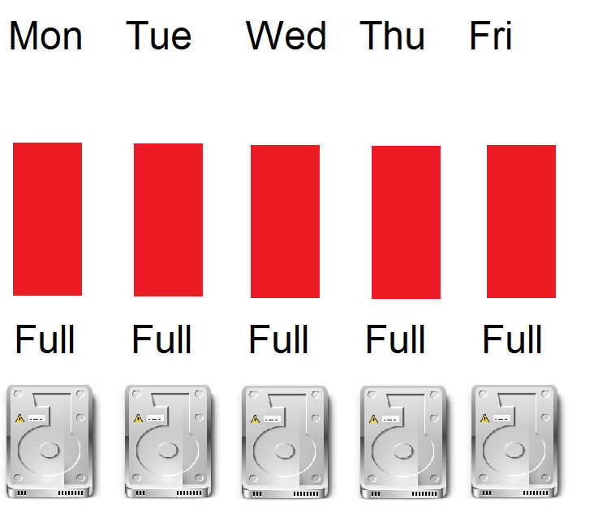
Full Backup
All data everyday!
Clear archive bit after backups

Slide 31
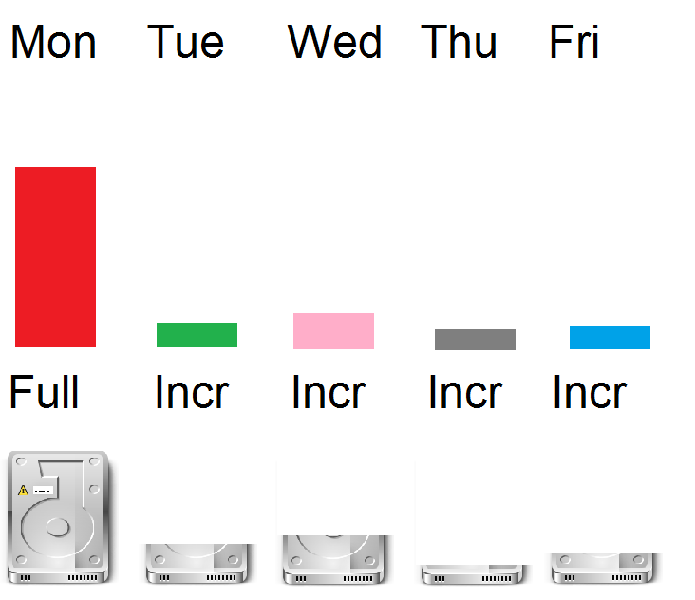
Incremental Backup
Only files that changed since last full or last incr
Reset the archive bit

Slide 32
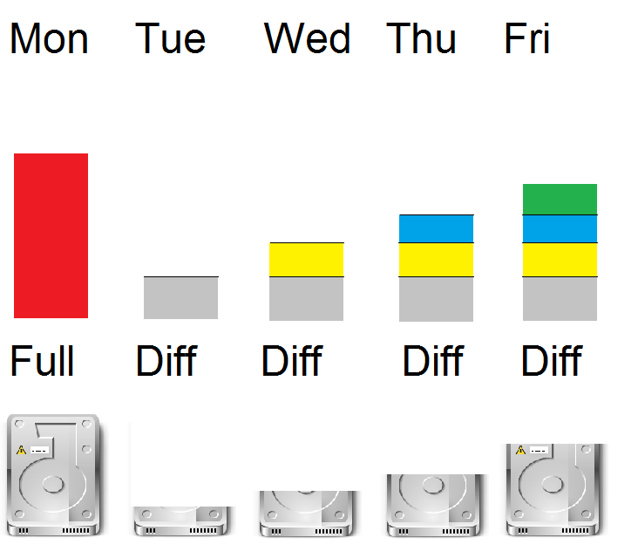
Diffirential Backup
Only files changed since last full or diff
DO NOT reset the archive bit

Slide 33
Offsite storage
Hot site
Warm site
Cold site

Slide 34
Hot Site
Fully configured and ready to operate within a few hours of a disaster
Can support a short- or long-term outage
Flexible in its configuration and options
Advantages
Ready for operation within hours
High availability
Flexible configurations
Annual testing available
Exclusive use
Disadvantages
Very expensive (can be more than double the data-center costs)

Slide 35
Warm Site
Partially configured with some equipment
Provides the facility and some peripheral devices, but not a full configuration
Advantages
Less expensive
Usually exclusive use
Available for long time frames
Disadvantages
Not immediately available
Operational testing usually not available

Slide 36
Cold Site
Supplies basic computing environments, including wiring, ventilation, plumbing, and flooring
Advantages
Relatively low cost
Disadvantages
No hardware infrastructure
Not immediately available
Operational testing not available

Slide 37
Denial of Service Attacks
Consumes or disables resources in order to interrupt services to legitimate users
Modes of attack
Crash application or OS
Clog network connections to a Web server
Overload victim system by consuming resources
Use normal procedures to deny access to users
Crash network device using remote access
Overload DNS server with lookup requests

Slide 38
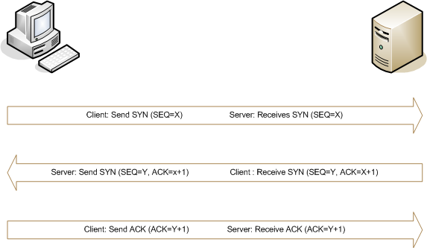
TCP Three way Handshake

Slide 39
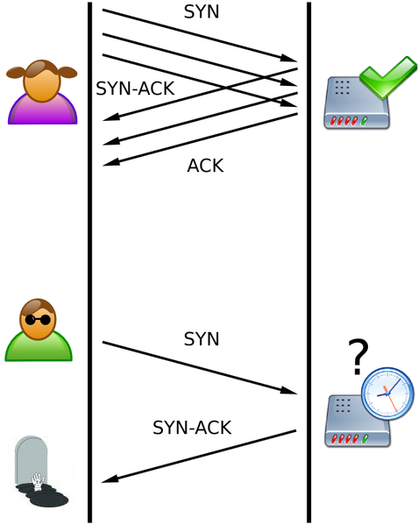
SYN Flood
Floods target server with half-open TCP connections
Exploits the TCP “handshake”
SYN
SYN/ACK
ACK

Slide 40
Distributed Denial of Service Attacks
Distributed Denial of Service – Overwhelm the victim by sheer numbers.
Take over computers (bots/zombies)
Build a command and control network using masters and slaves.
Often using IRC or other pubic services
Control hundreds or thousands of computers and attack another.

Slide 41
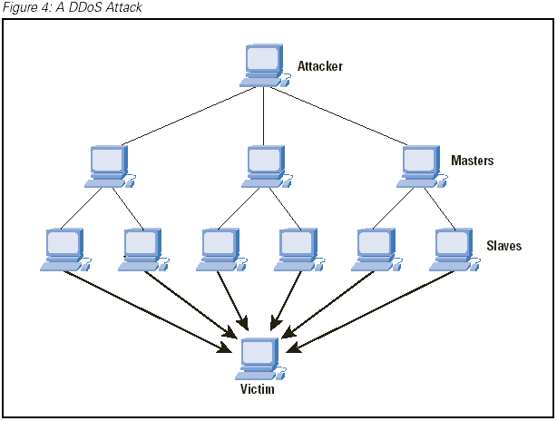
Distributed Denial of Service Attacks

Slide 42
DDoS Countermesures
Clients and servers
Install security patches and updates
Install and configure personal firewalls
Install and maintain antivirus software
Perform regular antivirus scans
E-mail servers
Install and maintain antivirus software

Slide 43
DDoS Countermesures
Firewalls and routers
Filter inbound and outbound packets
Turn off directed broadcasts on internal routers
Block RFC 1918, multicast and loopback addresses
Block packets with foreign protocol or port
Block incoming packets with network’s source address
Block outgoing packets with fake source address

Slide 44
Spoofing
Act of falsely identifying a packet’s IP address, MAC address…
Four primary types:
IP address spoofing
ARP poisoning
Web spoofing
DNS spoofing

Slide 45
IP Address Spoofing
Used to exploit trust relationships between two hosts
Trust relationship could be enforced at the router, the firewall, by an application, or by the OS

Slide 46
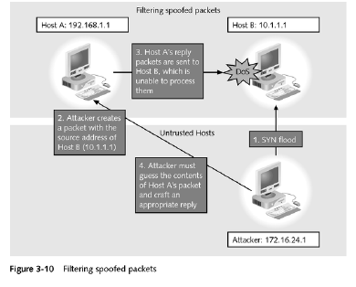
IP Address Spoofing

Slide 47
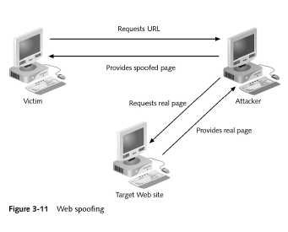
Web Spoofing

Slide 48
Man in the Middle
Class of attacks in which the attackers places himself between two communicating hosts and listens on their session
Both of the other hosts think they are communicating with each other

Slide 49
Man in the Middle Applications
Web spoofing
TCP session hijacking
Information theft
Other attacks (denial-of-service attacks, corruption of transmitted data, traffic analysis to gain information about victim’s network)

Slide 50
Countermeasures
Use encrypted applications (SSL)
Use encrypted network communications (VPNs)
Use switches
Restrict physical access to networks
Use 802.1x to require authorization before allowing network use

Slide 51
Viruses
Self-replicating programs that spread by “infecting” other programs
Attach or embed themselves in other programs
When program runs, virus is executed
Damaging and costly

Slide 52
Protecting Against Virues
Enterprise virus protection solutions
Desktop antivirus programs
Virus filters for e-mail servers
Network appliances that detect and remove viruses
Instill good behaviors in users and system administrator
Keep security patches and virus signature databases up to date
Train users to not open unsolicited attachments
Unhide file extensions

Slide 53
Backdoors (Programs)
Remote access program surreptitiously installed on user computers that allows attack to control behavior of victim’s computer
Also known as remote access Trojans
Detection and elimination
Up-to-date antivirus software
Intrusion detection systems (IDS)

Slide 54
Trojan Horses
Disguised as a useful program. It might even might do something useful to keep up the disguise. But will cause you harm.
Countermeasures
User Education
Don’t run software that you are not familiar with and that you don’t have “real distribution” media for.
Software Digital Signing
Anti-virus software to detect known Trojans

Slide 55
Logic Bombs
Logic Bomb – Code or applications embedded into a system that waits for a specific time or event then goes off doing some type of damage.
Countermeasures
Inventory all software and keep checksums. Tripwire is a popular program that provides file integrity verification.

Slide 56
Worms
Worms – work differently than viruses
Self-propagate
Do damage
Counter measures
Remove un-necessary services
Patch OS and applications
Filter all the traffic you can at the firewall
Network and host-based Intrusion Detection Systems
Antivirus programs

Slide 57
Rootkits
Software installed on a system to hide the presence of an attacker.
Can consist of
Replaced system software
Loadable kernel modules

